Slide 1
Online MCAS Performance Appeals: A Step-by-Step Guide

Slide 2
CONTENTS

Slide 3
Create and Submit MCAS Performance Appeals using the Online Portal
01

Slide 4
Online MCAS Appeals Application Process
How To:
Log in to the Security Portal.
Create a new MCAS Performance Appeal Application.
Enter SASID and student demographic information.
Select appeal type.
Review eligibility requirements.
Attach supporting documents.
Review supporting documents.
Sign off and submit appeal.
Complete a partially completed appeal that was created earlier.

Slide 5
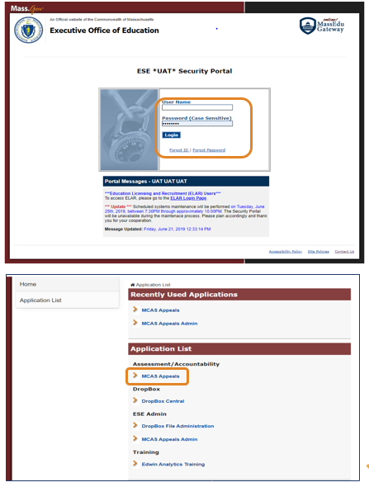
Step 1: Log in to the Security Portal and Select the MCAS Appeals Application
District MCAS Appeals user will log in to Security Portal using User Name and Password.
Contact the district’s Directory Administrator for assistance, if user cannot access Security Portal.
Then, find Applications List and click MCAS Appeals Application to begin entering an appeal.
Notes:
Notes: The user must be assigned the MCAS Appeals Role by their Directory Administrator. The User’s Name and Password are case sensitive.

Slide 6
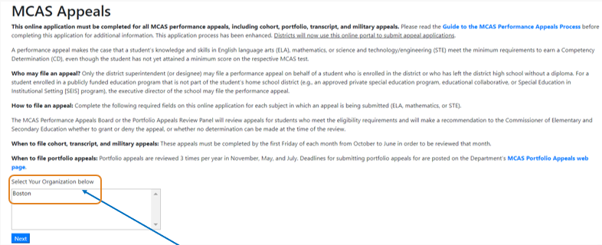
Step 2: Select Your Organization
Select an organization in the “Select Your Organization below” box then select “Next” to proceed.
Notes:
Note: Some users will see more than one organization depending on their role.

Slide 7
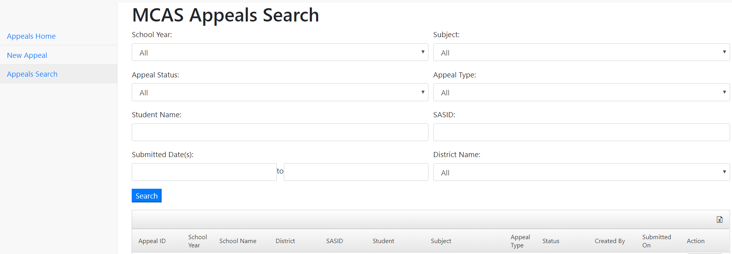
Step 3: Create a “New Appeal”
At the MCAS Appeals Search page:
Select the “New Appeal” link to begin a new appeal for a student.
Notes:
Note: For MCAS Appeals that have already been created, select the unique “Appeal ID” to review an appeal application for a student.

Slide 8
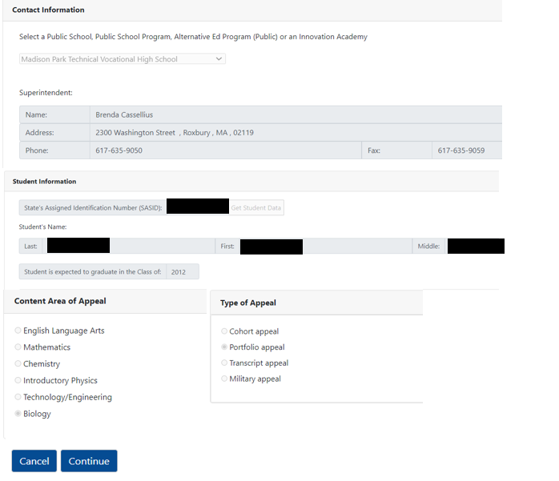
Step 4: Begin an appeals application for a specific student: Complete the General Information section.
Complete all of the required fields.
Then–Select “Continue”
The first section of the appeal application will be automatically saved.
Notes:
Note: The correct superintendent and principal should be pre-populated based on the school that is selected. If incorrect, the user should update the information in school profiles.
If the student’s SASID is incorrect, you will not be able to enter the appeal. If the SASID is correct, but the student left school more than 5 years ago contact mcas@doe.mass.edu for assistance.

Slide 9
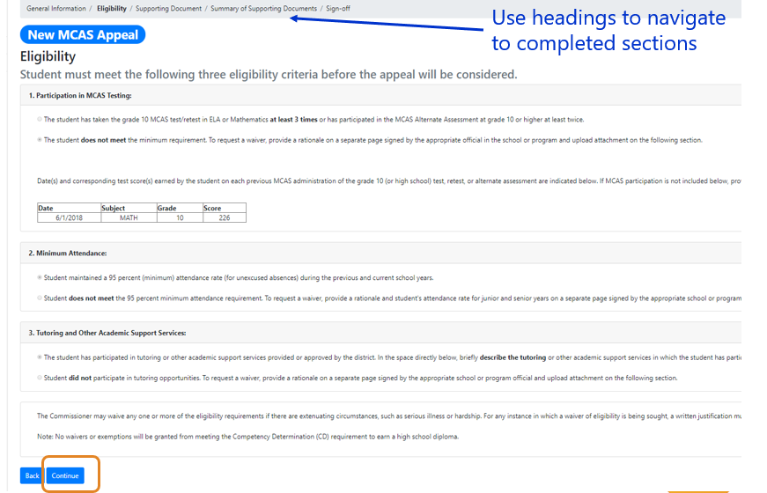
Step 5: Complete the required Eligibility section.
Each type of appeal has specific eligibility requirements.
Answer each eligibility question.
Then–Select “Continue” to proceed and save the second section of the appeal application.
Notes:
Note: When a student does not meet one or more the eligibility requirements, such as the MCAS participation requirement, it will be required to upload one or more “Eligibility Waiver Request” documents.

Slide 10
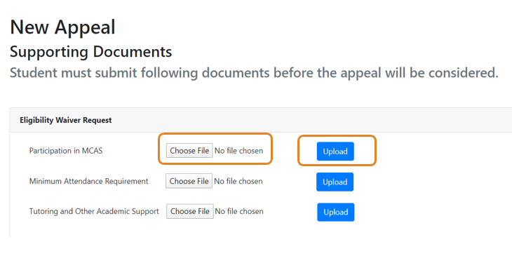
Step 6: Upload Supporting Documents
Upload Eligibility Waiver Request(s), if required.
Select “Choose File.”
Locate the file saved on your computer or drive and select the file to be uploaded.
Then, select the upload button.
Notes:
Note: Each type of appeal will require the upload of supporting documents (e.g., cohort worksheets, course descriptions, transcripts, etc.). If an eligibility wavier is necessary, the waiver request must be uploaded at this “Supporting Document” section.

Slide 11
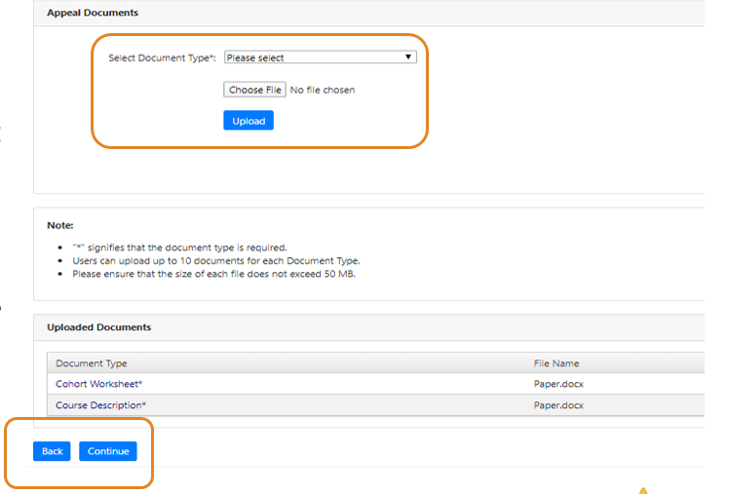
Step 6: Upload Other Supporting Documents (Continued)
Upload Supporting “Appeals Documents”
Use the “Select Document type” dropdown and select the correct document.
Click on “Choose File.”
Locate the correct file on your computer or drive and select the file to be uploaded.
Then, select Upload.
Select “Continue” to proceed and save.
Notes:
Notes: An asterisk (*) indicates that the specific document type is required. All successfully uploaded documents will appear in the “Uploaded Documents” section. Uploaded documents may be deleted.

Slide 12
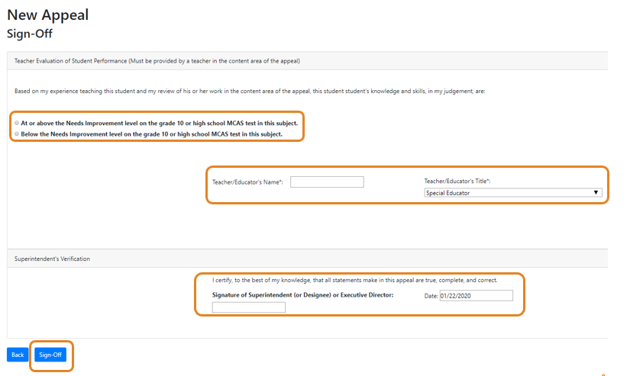
Step 7: Complete Sign-Off Section and Submit Appeal Application
Before submitting appeal, complete the Teacher’s Evaluation section and Superintendent’s Verification.
Complete the required fields, then select the “Sign-Off” to submit the appeal.
Notes:
Note: Once the completed appeal is reviewed and a decision has been made, the information and documents that are submitted cannot be changed. If the student’s appeal is not granted, the school may easily resubmit another appeal for the student with additional information.

Slide 13
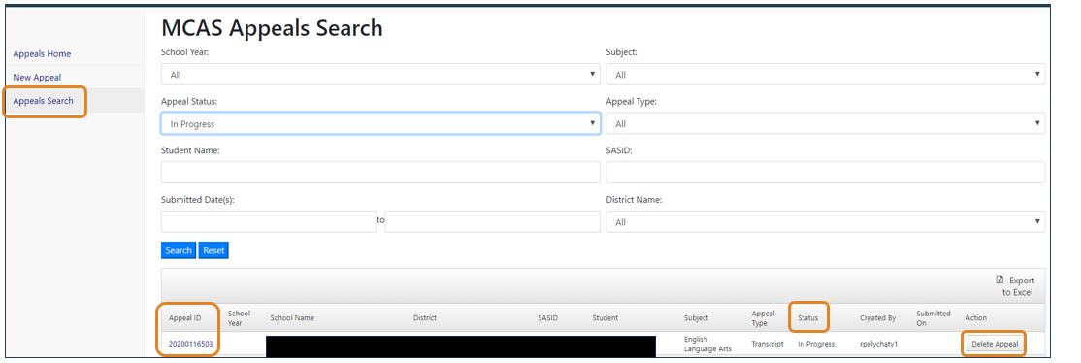
Complete an Appeal Started on an Earlier Date
Steps:
Log-in to MCAS Appeals application and select “Appeals Search”
Select appeal “Status” to search for “In Progress” appeals (not yet submitted).
Select “Appeal ID” to edit the application; or select “Delete Appeal” to remove “In Progress” application.
Notes:
Notes: Once the General Information section of the application is completed, the student’s appeal application will be automatically saved. Each appeal will be in an “In Progress” status until it is submitted. The student’s appeal can be completed at future date, and each “In Progress” appeal may also be deleted if the district does not want to submit the appeal or creates an appeal by error.

Slide 14
View Results and
Develop Customized Searches
02

Slide 15
Viewing Results and Additional Features
View appeal status, decisions, search, print, resubmit, and create reports
MCAS Appeals Search
District user can sort, filter, and review all appeals entered by the district.
Appeals Search status is available in real time.
Download and Print Decisions
Users will download decisions that must be shared with the student and/or parent (e.g., Parent Letter and Record of Performance)
Resubmit an Appeal
Appeals with a No-Determination or Denied decision can be resubmitted with additional information.

Slide 16
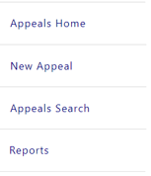
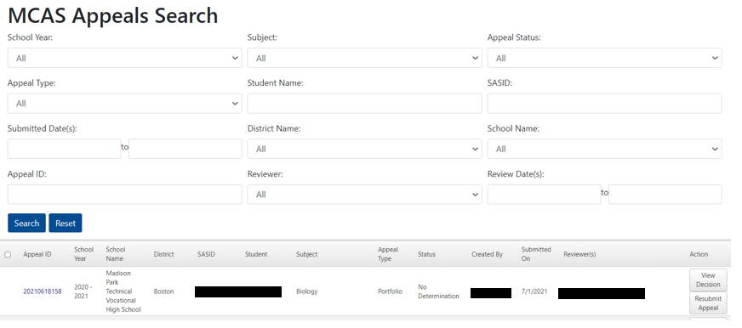
Review Appeals Status Using MCAS Appeals Search
Steps:
Log in and select “Appeals Search.”
Use following fields to search for appeals for specific students:
Subject, Status, Appeal Type, Student Name, SASID
View results in real time by viewing appeal “Status”
Click on “View Decision” icon to see results.

Slide 17
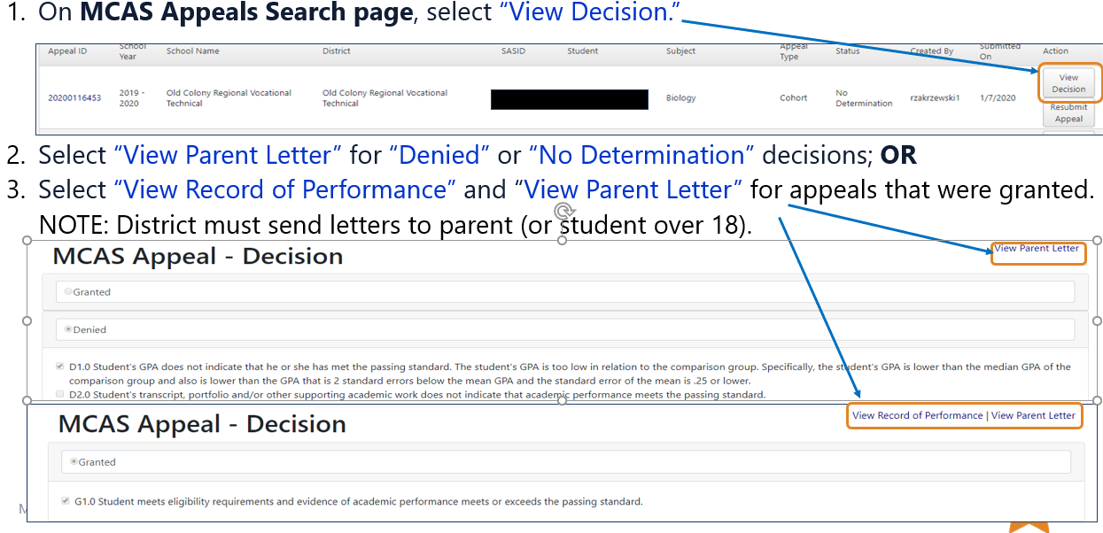
Download and Print Decisions and Parent Letters
Notes:
Note: All letters can be printed using the web browser print function.

Slide 18
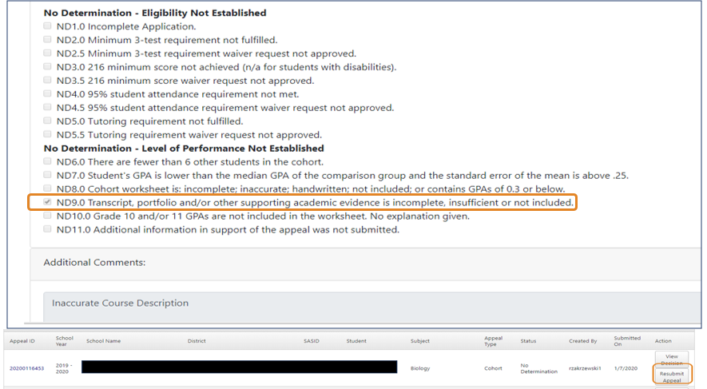
Resubmit an Appeal with a “No Determination” or “Denied” Status
Steps to resubmit an appeal:
On MCAS Appeals Search page, view decision and why appeal was either Denied or No Determination.
Select “Resubmit Appeal”
Add missing or new information.
District must complete sign-off section again.
NOTE:
All previously entered information will be saved.

Slide 19
Districts Can Create Customized Searches
Sample Customized Search – View all current Mathematics cohort appeals in the district for which a finding of No Determination was made.
Steps:
At MCAS Appeals Search, select the “No Determination,” “Mathematics,” and “Cohort,” search fields.
Then, select “Search” to view all filtered results.

Slide 20
Exporting and Using Customized Search Results
Once filtered results appear, they can be exported to an Excel file.
Select “Export to Excel.”
Can be used to review appeals that need to be resubmitted.

Slide 21
How to Use the Reports Function to Generate Specific Reports
03

Slide 22
New Reports Function
The online MCAS Performance Appeals application process using the Department’s Security Portal was introduced in 2020.
DESE has now enhanced the MCAS Appeals application to compile and make available all appeals results since 2004.
Districts can now:
generate school and district level results
disaggregate results by subgroup, student, subject, date, and decisions
print a collection of reports

Slide 23
Options for Generating Specialized Reports
Four report options:
Decisions by School/District
displays specific decision codes provided for all appeals
Number of Appeals by Student Status, Content Area, and Review Month/Year
a numerical tabulation of appeals granted and denied and organized by student status (SWD or Non-SWD) and content area of appeal
Records of Performance by Date
provides verification letter indicating students whose appeals were granted (a copy should be mailed to student/parent when the decision was made)
Appeals by Subgroup
results disaggregated by student status, gender, and race/ethnicity
For each report option, district user can further disaggregate the results using the search filter tools. All reports can be printed.

Slide 24
Select Type of Report
Select a specific type of report, either:
Decisions by School/District
Number of Appeals
Records of Performance by Date
Appeals by Subgroup

Slide 25
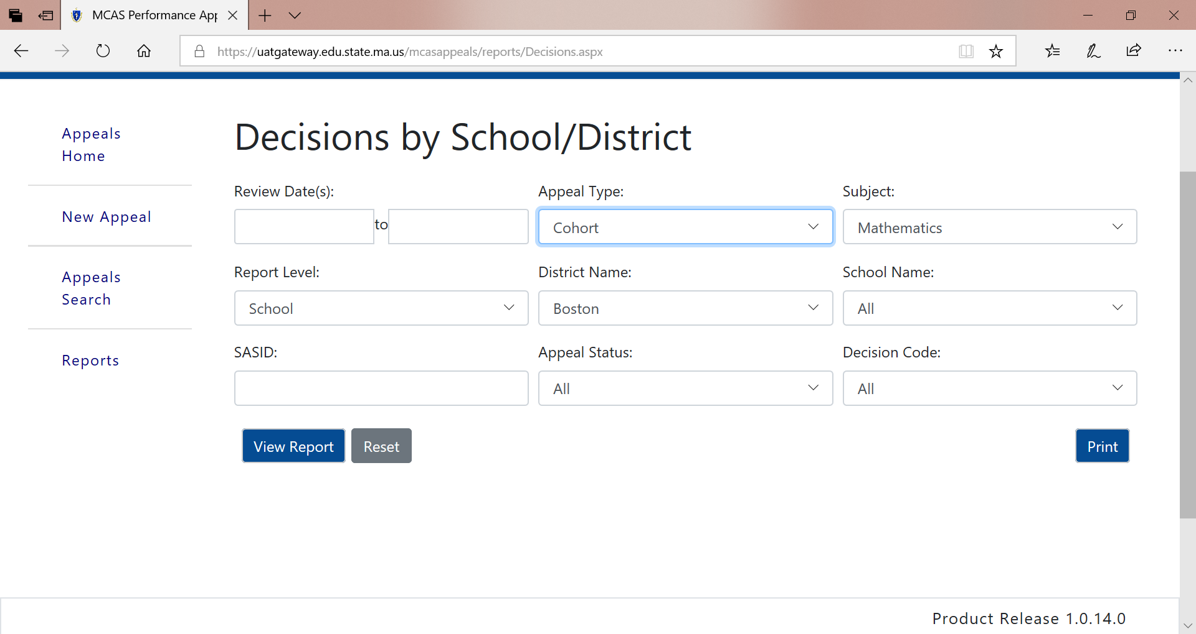
Report Option: Decisions by School/District
If desired, use filters to disaggregate results by Review Date, Appeal Type, School (Some districts may have more than once high school.), SASID, Appeal Status, and Decision Code. Then select “View Report.” (See sample report on next slide.)

Slide 26
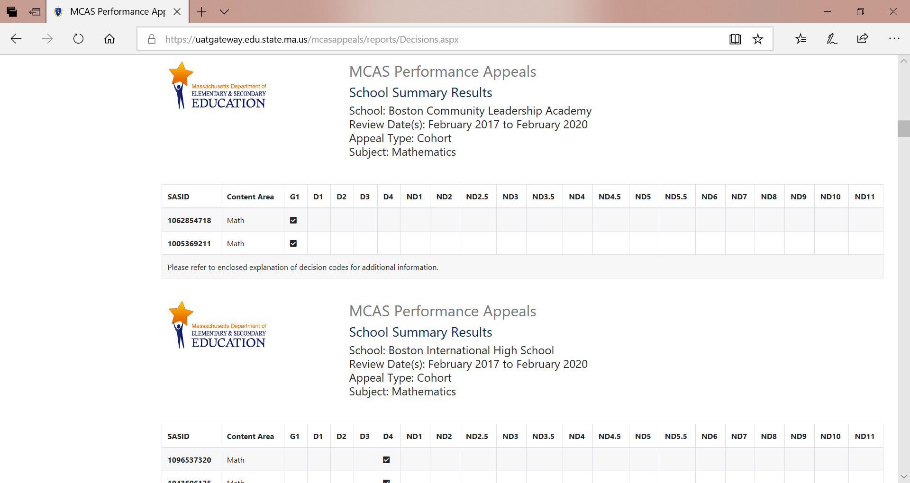
Sample Report for Decisions by School/District

Slide 27
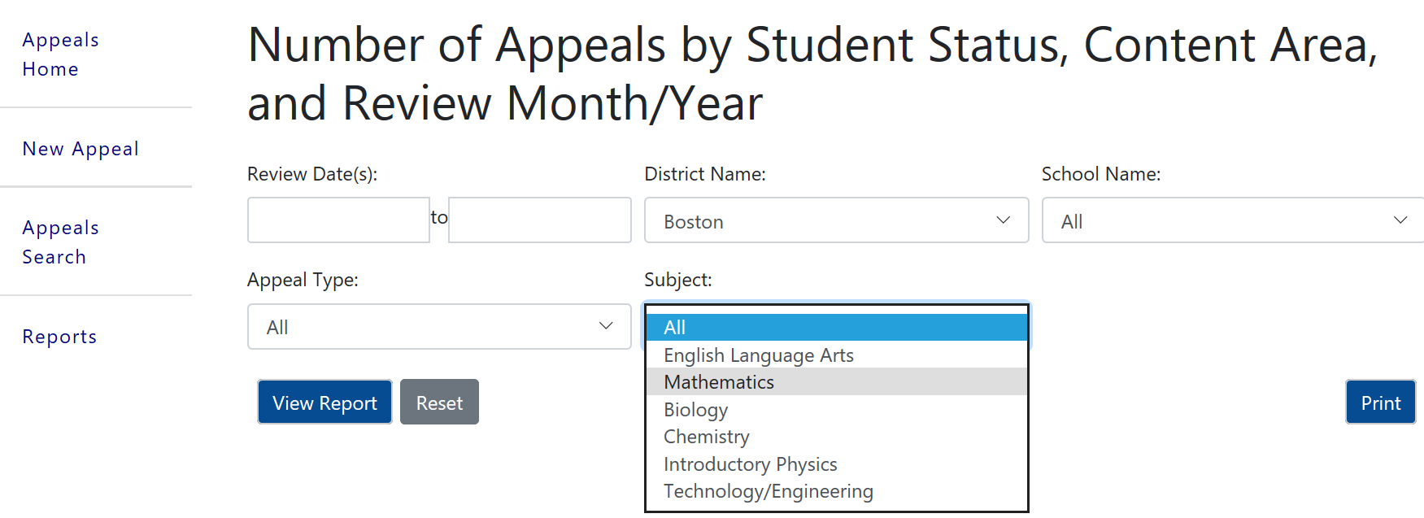
Report Option: Number of Appeals by Student Status, Content Area, and Review Month/Year
If desired, use filters to disaggregate results by Review Date, Appeal Type, School, and Subject (See sample report on next slide.). Then select “View Report.”

Slide 28
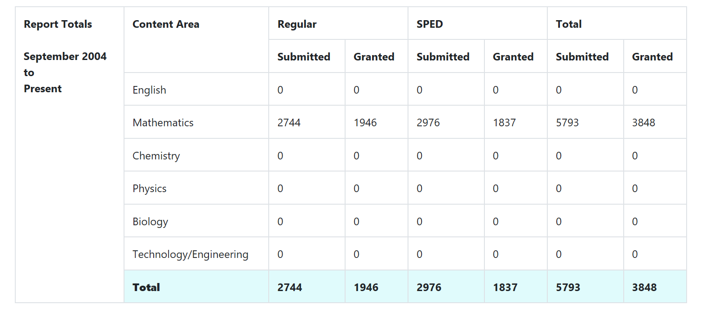
Sample Report for Number of Appeals
Note: Since Mathematics filter was selected, only Mathematics content area appeals are displayed.

Slide 29
Report Option: Records of Performance by Date
If desired, use filter results by Review Date, School (if district has more than one high school), and SASID. (See sample report on next slide.) Then select “View Report.”

Slide 30
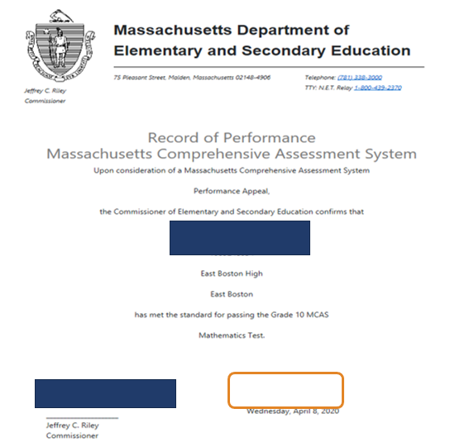
Sample Report: Record of Performance by Date
District is required to keep on copy and give one copy to student for evidence that the student met the subject specific CD requirement.
Note: Dates are only provided for appeals submitted after October 2019.

Slide 31
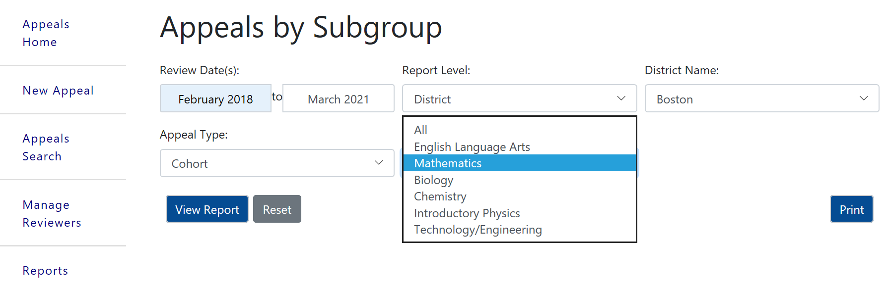
Report Option: Appeals by Subgroup
If desired, use filters to disaggregate results by Review Date, School, and Appeal Type and Subject. (See sample report on next slide.) Then, select “View Report.”

Slide 32
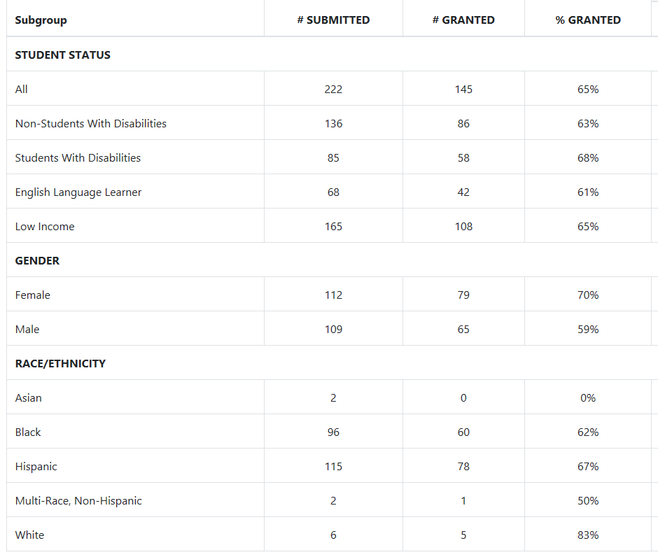
Sample Report: Appeals by Subgroup

Slide 33
Print Feature
Once report is generated, select “Print” to use web browser printing feature.

Slide 34
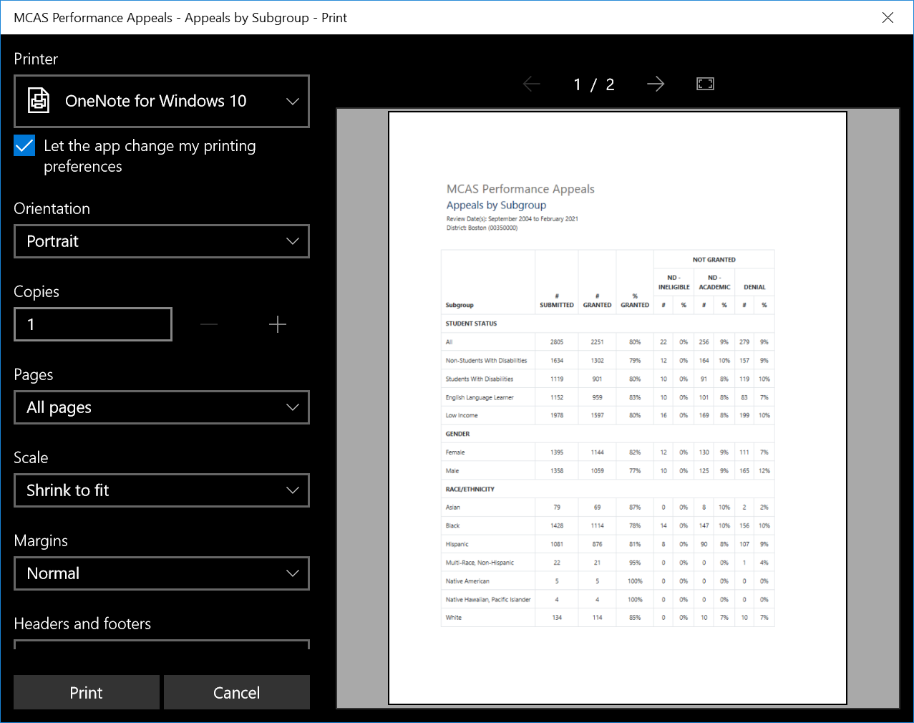
Sample: Print Preview

Slide 35
Email and Phone Support
DESE Office of Student Assessment Services
Policy questions and technical assistance (e.g., eligibly requirements, graduation requirements, required supporting documents, students with disabilities)
Web: http://www.doe.mass.edu/mcasappeals/
Email: mcas@doe.mass.edu
Phone: 781-338-3625

